Slide 1
Chapter 4
Context Free Grammar and Context Free Languages

Slide 2
Outline
Context Free Grammar
Derivations and Sentential forms
Leftmost and Rightmost derivation and Derivation Trees
Ambiguity of Grammar and Language
Simplification of CFGs
Normal Forms
Chmosky Normal Form (CNF)
Greibach Normal Form (GNF)
Pumping Lemma for Context Free Languages

Slide 3
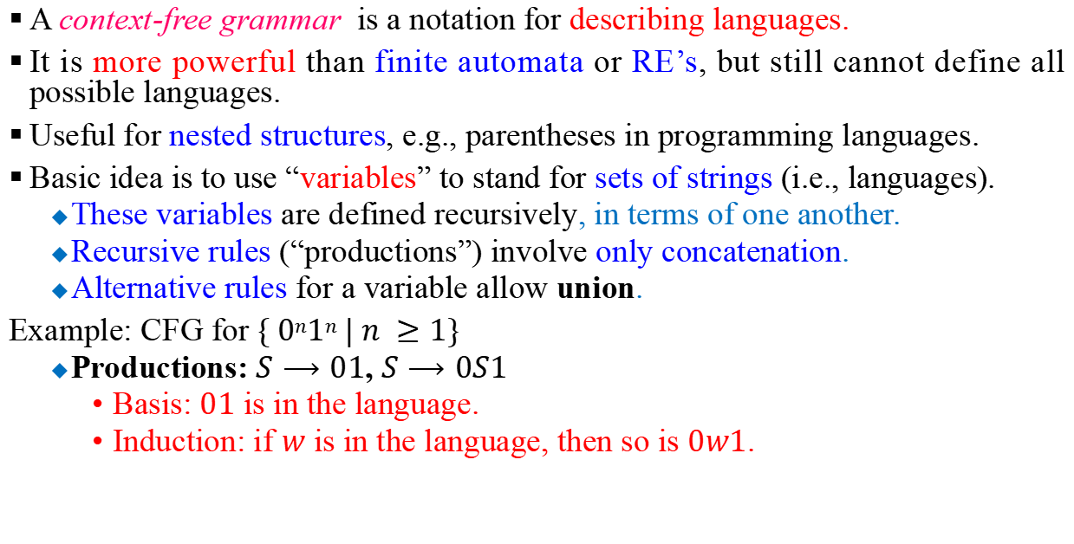
Context Free Grammar
A context-free grammar is a notation for describing languages.
It is more powerful than finite automata or RE’s, but still cannot define all possible languages.
Useful for nested structures, e.g., parentheses in programming languages.
Basic idea is to use “variables” to stand for sets of strings (i.e., languages).
These variables are defined recursively, in terms of one another.
Recursive rules (“productions”) involve only concatenation.
Alternative rules for a variable allow union.
Example: CFG for $\{ 0n1n | n ≥1\}$
Productions: $S⟶01$, $S⟶0S1$
Basis: $01$ is in the language.
Induction: if $w$ is in the language, then so is $0w1$.

Slide 4
Formal Definitions
Grammar:
Set of
variables
Set of
terminal
symbols
Start
variable
Set of
productions

Slide 5
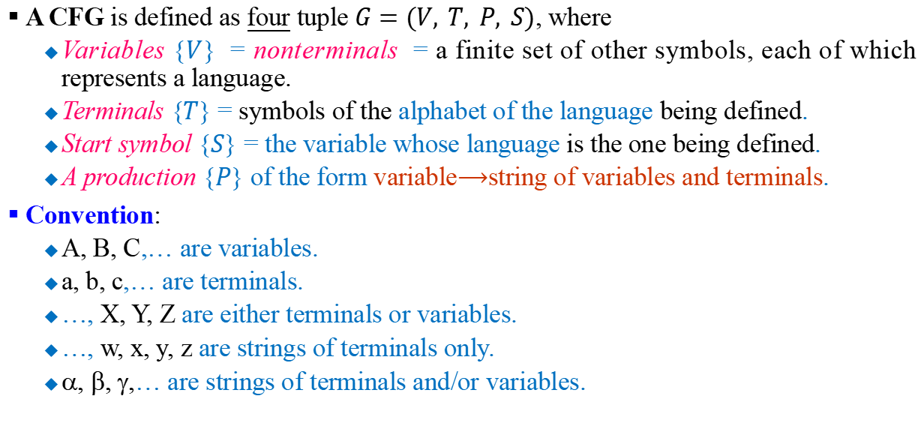
Formal Definition of CFG
A CFG is defined as four tuple $G=(V, T, P, S)$, where
Variables {$V$} = nonterminals = a finite set of other symbols, each of which represents a language.
Terminals {$T$} = symbols of the alphabet of the language being defined.
Start symbol {$S$} = the variable whose language is the one being defined.
A production {$P$} of the form variable$⟶$string of variables and terminals.
Convention:
A, B, C,… are variables.
a, b, c,… are terminals.
…, X, Y, Z are either terminals or variables.
…, w, x, y, z are strings of terminals only.
α, β, γ,… are strings of terminals and/or variables.

Slide 6
Context-Free Grammar:
All productions in are of the form
Variable
String of variables and terminals
* The restriction on the right side of the productions made on regular grammar regarding the number and position of variables are relaxed.

Slide 7
Example of Context-Free Grammar
Productions
start variable
variables
Terminals

Slide 8
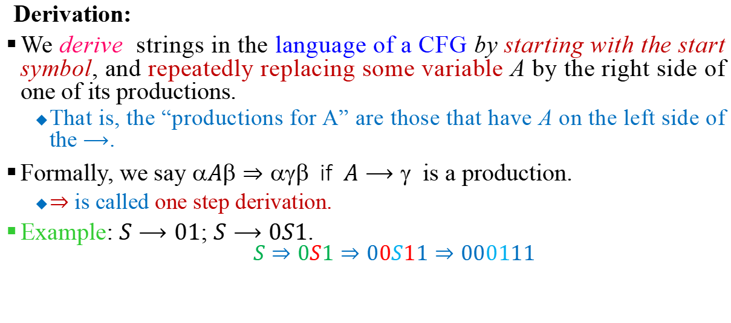
Derivations and Sentential Forms
Derivation:
We derive strings in the language of a CFG by starting with the start symbol, and repeatedly replacing some variable A by the right side of one of its productions.
That is, the “productions for A” are those that have A on the left side of the $⟶$.
Formally, we say $A⇒$ if $A⟶$ is a production.
$⇒$ is called one step derivation.
Example: $S⟶01$; $S⟶0S1$.
$$S⇒0S1⇒00S11⇒000111$$

Slide 9
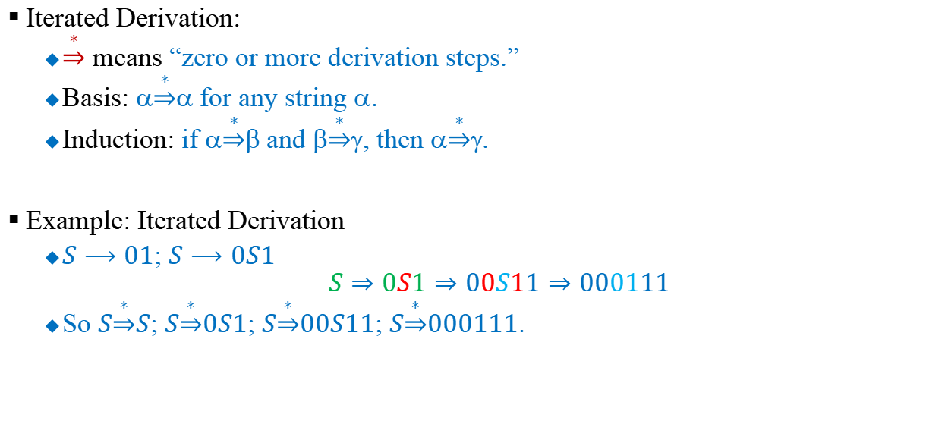
Derivations and Sentential Forms
Iterated Derivation:
$\underset{⇒}{∗}$ means “zero or more derivation steps.”
Basis: $\underset{⇒}{∗}α$for any string $$.
Induction: if $\underset{⇒}{∗}β$and $\underset{⇒}{∗}γ$, then $\underset{⇒}{∗}γ$.
Example: Iterated Derivation
$S⟶01$; $S⟶0S1$
$$S⇒0S1⇒00S11⇒000111$$
So $S\underset{⇒}{∗}S$; $S\underset{⇒}{∗}0S1$; $S\underset{⇒}{∗}00S11$; $S\underset{⇒}{∗}000111$.

Slide 10

Derivations and Sentential Forms
Sentential Forms:
Any string of variables and/or terminals derived from the start symbol is called a sentential form.
Formally, $$ is a sentential form iff $S\underset{⇒}{∗}α$.
For a grammar $G$ with start variable $S$
String of terminals or λ

Slide 11
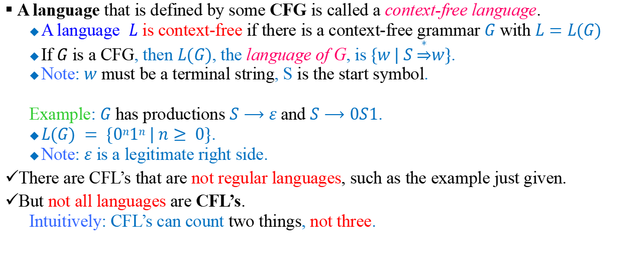
Context Free Languages
A language that is defined by some CFG is called a context-free language.
A language $L$ is context-free if there is a context-free grammar $G$ with $L=L(G)$
If $G$ is a CFG, then $L(G)$, the language of G, is $\{w | S \underset{⇒}{∗}w\}$.
Note: $w$ must be a terminal string, S is the start symbol.
Example: $G$ has productions $S⟶ε$and $S⟶0S1$.
$L(G) = \{0n1n | n≥ 0\}$.
Note: $ε$ is a legitimate right side.
There are CFL’s that are not regular languages, such as the example just given.
But not all languages are CFL’s.
Intuitively: CFL’s can count two things, not three.

Slide 12
Example:
is a context-free language
since context-free grammar $G$ :
generates

Slide 13
Another Example
Context-free grammar $G$ :
Example derivations:
Palindromes of even length

Slide 14

Another Example
Context-free grammar $G$ :
Example derivations:
Describes
balanced
parentheses:
A core idea of most programming languages.
() ((( ))) (( ))

Slide 15
Another Example
S → aB | bA
A → a | aS | bAA
B → b | bS | aBB
Is ab, baba, abbbaa in L?
How about a, bba,abbaba?
Show with the possible derivations.

Slide 16
Another Example
Construct a grammar that generates the language:
L={a^{n}b^{n}c^{i}|n≥0,i≥0}
Answer:
S → S₁S₂
S₁ → aS₁b| ε
S₂ → cS₂ |ε
Check your answer by deriving abc, aabbc, aaabbbcccc

Slide 17
Another Example
Write the productions of CFG that accept the language:
L= {ab (bbaa)^{n} bba|n≥0}
Ans: S → S₁S₂S₃
S₁ → ab
S₂ → bbaaS₂ |ε
S₃ → bba
Ans: S → abABa
A → bbaaA|ε
B → bb

Slide 18
Leftmost and Rightmost Derivations and Derivation Trees

Slide 19
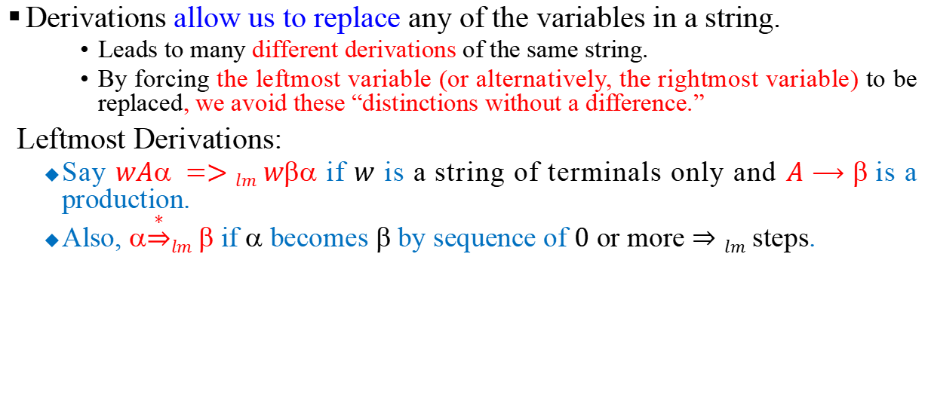
Leftmost and Rightmost Derivations
Derivations allow us to replace any of the variables in a string.
Leads to many different derivations of the same string.
By forcing the leftmost variable (or alternatively, the rightmost variable) to be replaced, we avoid these “distinctions without a difference.”
Leftmost Derivations:
Say $wA =>lm w$ if $w$ is a string of terminals only and $A⟶$is a production.
Also, $\underset{⇒}{∗}lm $ if $$ becomes $$ by sequence of $0$ or more $⇒lm$ steps.

Slide 20
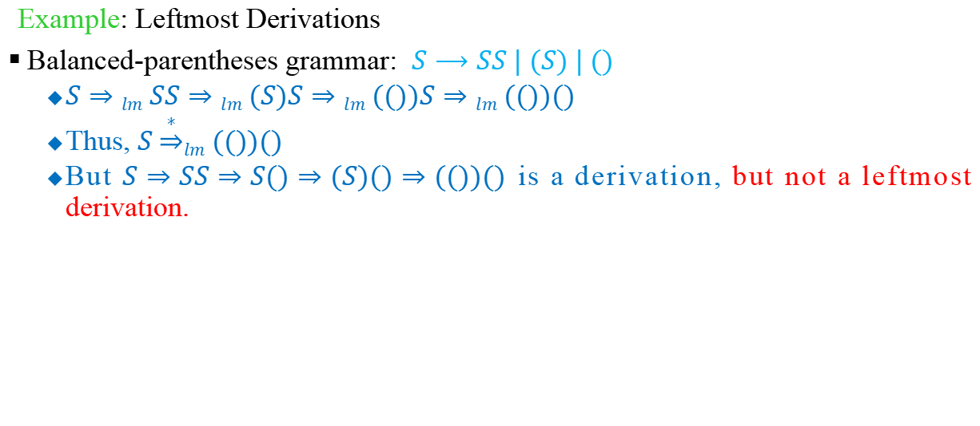
Leftmost and Rightmost Derivations
Example: Leftmost Derivations
Balanced-parentheses grammar: $S⟶SS | (S) | ()$
$S⇒lm SS⇒lm (S)S⇒lm (())S⇒lm (())()$
Thus, $S \underset{⇒}{∗}lm (())()$
But $S⇒SS⇒S()⇒(S)()⇒(())()$ is a derivation, but not a leftmost derivation.

Slide 21
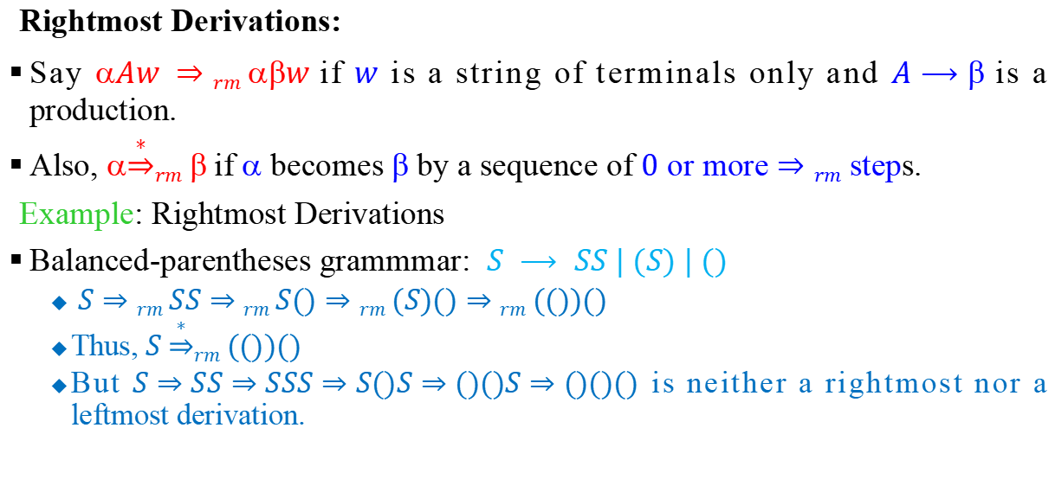
Leftmost and Rightmost Derivations
Rightmost Derivations:
Say $Aw ⇒rm w$if $w$ is a string of terminals only and $A⟶$is a production.
Also, $\underset{⇒}{∗}rm $if $$ becomes $$ by a sequence of $0$ or more $⇒rm$ steps.
Example: Rightmost Derivations
Balanced-parentheses grammmar: $S ⟶ SS | (S) | ()$
$S⇒rm SS⇒rm S()⇒rm (S)()⇒rm (())()$
Thus, $S \underset{⇒}{∗}rm (())()$
But $S⇒SS⇒SSS⇒S()S⇒()()S⇒()()()$ is neither a rightmost nor a leftmost derivation.

Slide 22
Derivation Order
Consider the following example grammar with 5 productions:
Leftmost derivation order of string :
At each step, we substitute the leftmost variable

Slide 23
Rightmost derivation order of string :
At each step, we substitute the rightmost variable

Slide 24
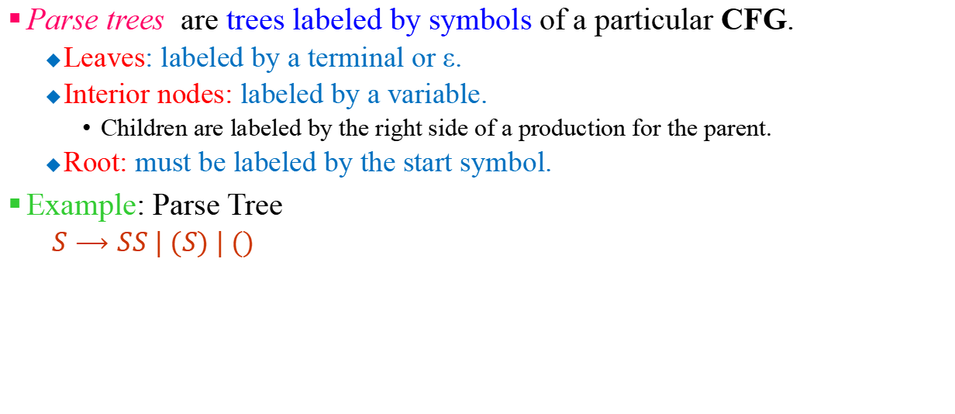
Derivation Trees (Parse Trees)
Parse trees are trees labeled by symbols of a particular CFG.
Leaves: labeled by a terminal or ε.
Interior nodes: labeled by a variable.
Children are labeled by the right side of a production for the parent.
Root: must be labeled by the start symbol.
Example: Parse Tree
$S⟶SS | (S) | ()$
S
S
S
(
S
)
(
)
(
)

Slide 25
Yield of Parse Tree
Yield of the parse tree is the concatenation of the labels of the leaves in left-to-right order
That is, in the order of a preorder traversal.
Example: yield of below parse tree is (())()
S
S
S
(
S
)
(
)
(
)

Slide 26
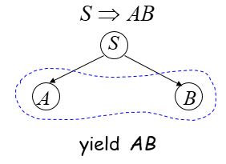
Yield of Parse Tree
Consider the same example grammar:
And a derivation of :

Slide 27
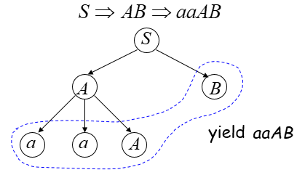

Slide 28
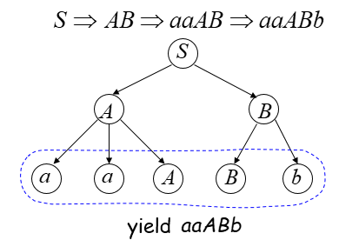

Slide 29
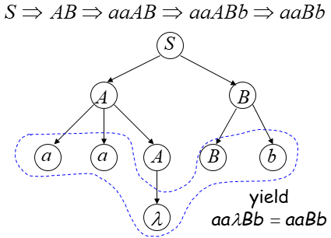

Slide 30
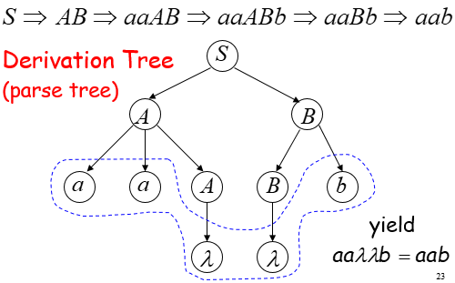

Slide 31
S → aAS | a A → SbA | SS | ba
Consider the CFG with the above production rules:
Find the Left most & Right most derivations and construct a parse tree (Generation tree) for generating the strings:
aabaaa
abaabaa
aabaabbaaaa

Slide 32
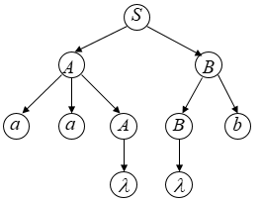
Sometimes, derivation order doesn’t matter
Leftmost derivation:
Rightmost derivation:
Give same derivation tree

Slide 33

Parse Trees, Left- and Rightmost Derivations
For every parse tree, there is a unique leftmost, and a unique rightmost derivation.
Exercise: Prove the following:
If there is a parse tree with root labeled $A$ and yield $w$, then $A \underset{⇒}{∗}lm w$.
If $A \underset{⇒}{∗}lm w$, then there is a parse tree with root $A$ and yield $w$.

Slide 34
Ambiguity of Grammars and Languages

Slide 35

Ambiguous Grammars
A CFG is ambiguous if there is a string in the language that is the yield of two or more parse trees.
Example: $S⟶SS | (S) | ()$
Two parse trees for the yield string ()()()
S
S
S
S
S
S
S
S
(
)
(
)
S
S
(
)
(
)
(
)

Slide 36
Grammar for mathematical expressions
Example strings:
Denotes any number

Slide 37
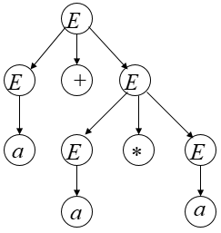
A leftmost derivation for

Slide 38
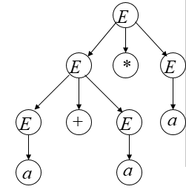
Another leftmost derivation for

Slide 39
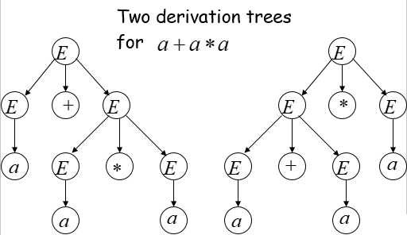

Slide 40
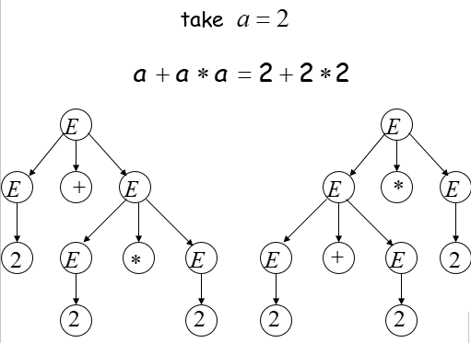

Slide 41
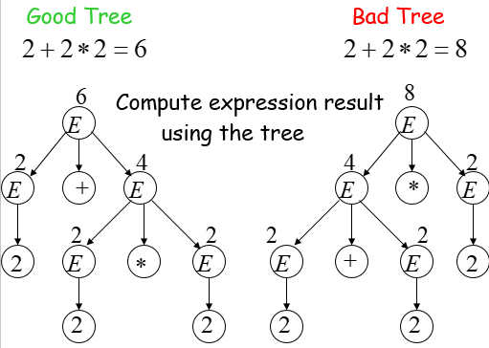

Slide 42
Two different derivation trees may cause problems in applications which use the derivation trees:
Evaluating expressions
In general, in compilers for programming languages

Slide 43
Ambiguous Grammar:
A context-free grammar is ambiguous
if there is a string which has:
Two different derivation trees or two leftmost derivations
(Two different derivation trees give two different leftmost derivations and vice-versa)

Slide 44
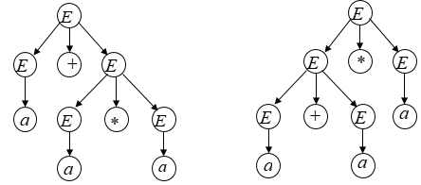
Example:
This grammar is ambiguous since
string
has two derivation trees

Slide 45
This grammar is also ambiguous because
string
has two leftmost derivations

Slide 46
Another ambiguous grammar:
STMT
if EXPR then STMT
if EXPR then STMT else STMT
Variables
Terminals
Very common piece of grammar in programming languages

Slide 47
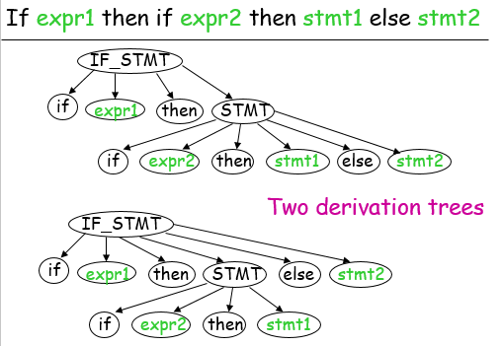

Slide 48
In general, ambiguity is bad and we want to remove it
Sometimes it is possible to find a non-ambiguous grammar for a language
But, in general we cannot do so

Slide 49
Disambiguation
Can we always disambiguate a grammar?
No, for two reasons
There exists an inherently ambiguous context-free L: Every CFG for this language is ambiguous
There is no general procedure that can tell if a grammar is ambiguous
However, grammars used in programming languages can typically be disambiguated

Slide 50
A successful example:
Ambiguous Grammar
Equivalent
Non-Ambiguous Grammar
generates the same language

Slide 51
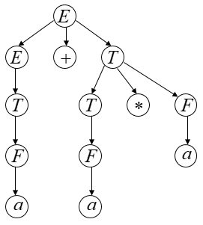
Unique derivation tree for

Slide 52

Disambiguation Exercise
Exercise:
For the balanced-parenthesis language grammar
$$S⟶SS | (S) | ()$$
Find an equivalent unambiguous grammar?
Define what an LL(1) grammar is?

Slide 53
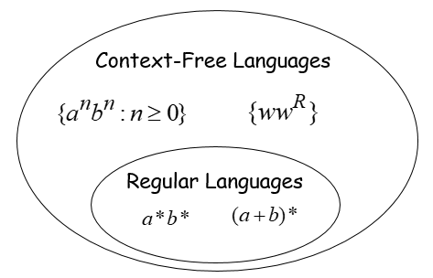

Slide 54
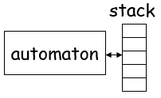
Context-Free Languages
Context-Free Grammars
Pushdown Automata

Slide 55
Simplification of CFGs

Slide 56
Simplifying CFGs
There are several ways in which context-free grammars can be simplified.
One natural way is to eliminate useless symbols
Those that cannot be part of a derivation (or parse tree)
Symbols may be useless in one of two ways.
they may not be reachable from the start symbol, or
they may be variables that cannot derive a string of terminals

Slide 57
Example of a useless symbol
Consider the CFG G with rules
S → aBC, B → b|Cb, C → c|cC, D → d
Here the symbols S, B, C, a, b, and c are reachable, but D is not.
D may be removed without changing L(G)

Slide 58
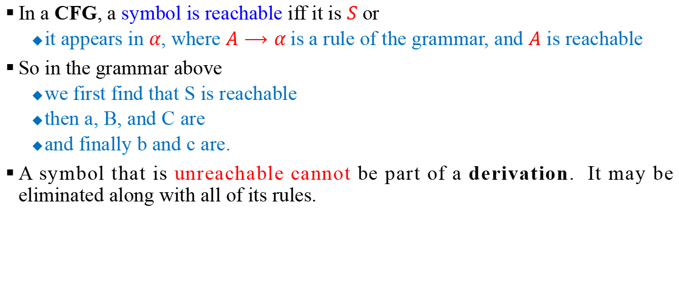
Reachable symbols
In a CFG, a symbol is reachable iff it is $S$ or
it appears in $α$, where $A⟶α$is a rule of the grammar, and $A$ is reachable
So in the grammar above
we first find that S is reachable
then a, B, and C are
and finally b and c are.
A symbol that is unreachable cannot be part of a derivation. It may be eliminated along with all of its rules.

Slide 59
Another reachability example
Suppose the grammar G instead had rules
S → aB, B → b|Cb, C → c|cC, D → d,
Then we would first see that S is reachable
then that a and B are
then that b and C are
and finally that c is
We might say in this case that
S is reachable at level 0,
a and B at level 1,
b and C at level 2,
and c at level 3.

Slide 60
A second kind of useless symbol
Two simple inductions show that X is reachable iff S =*> aXb for some strings a and b of symbols.
A symbol X is also useless iff it cannot derive a string of terminals
that is, iff there's no string w of terminals such that X =*> w.

Slide 61
Another simplification example
In the grammar with rules
S → aB, B → b|BD|cC, C → cC, D → d
the symbol C cannot derive a string of terminals.
So it and all rules that contain it may be eliminated to get just
S → aB, B → b|BD, D → d

Slide 62
Generating strings of terminals
A simple induction shows that the only symbols that can generate strings of terminals are
Terminal symbols
Variable A for which A → a is a rule of the grammar and every symbol of a generates a string of terminals

Slide 63
Our example revisited
S → aB, B → b|BD|cC, C → cC, D → d
In the grammar above, we would observe
first that a, b, c, and d generate strings of terminals (at level 0),
then that B and D do (at level 1),
and finally that S does (at level 2)

Slide 64
Removing the two kinds of useless symbols
The characterizations of the two kinds of useless symbols are similar, except that
To find reachable symbols, we work top down
To find generating symbols, we work bottom up.
When removing useless symbols, it’s important to remove unreachable symbols last
since only this order will leave only useful symbols at the end of the process.

Slide 65
Example of removing useless symbols
Using the algorithms implicit in the above characterizations, suppose a CFG has rules
S → aB, B → b|bB|CD, C → cC, D → d
We first observe that a, b, c, and d generate strings of terminals (at level 0)
then that B and D do (at level 1)
and finally that S does (at level 2).
But removing the rule B → CD from this grammar makes the symbol D unreachable.

Slide 66
Exercise on removing useless symbols
Eliminate the useless variables from the grammar given by the production rules:
1) S → aS|A|C
A → a
B → aa
C → aCb
2) S → aB|bC
A → Bac|bSC|a
B → aSB|bBC
C → SBc|aBC|ac
Answer:
S → aS|A
A → a
Answer:
S → bC
C → ac

Slide 67
Eliminating λ-rules
Sometimes it is desirable to eliminate l-rules from a grammar G.
This cannot be done if l is in L(G),
But it's always possible to eliminate l-rules from a CFG and get a grammar that generates L(G) - {l}.

Slide 68
Nullable symbols
Eliminating l-rules is like eliminating useless symbols.
We first define a nullable symbol A to be one such that A =*> l.
Then for every rule that contains a nullable symbol on the RHS, we add a version of the rule that doesn't contain this symbol.
Finally we remove all l-productions from the resulting grammar.

Slide 69
Nullability
Note that l is in L(G) iff S is nullable.
In this case a CFG with S → l as its only l-rule can be obtained by removing all other l-rules and then adding this rule.
Otherwise, removing l-rules gives a CFG that generates L(G) = L(G) - {l}
By a simple induction, A is nullable iff
G has a rule A → l, or
G has a rule A → a, where every symbol in a is nullable

Slide 70
Example: removing nullable symbols
Suppose G has the 9 rules
S → ABC | CDB, A → l|aA, B → b|bB,
C → l|cC, D → AC
Then A and C are nullable, as is D.
Optionally deleting nullable symbols adds:
S → BC | AB | B, S → DB | CB | B,
A → a, C → c, D → A | C
Removing A → l and C → l (and not adding D → l) gives a CFG with 16 distinct rules

Slide 71
Exercise on Eliminating λ−Productions
Remove Empty Productions from the following production rule of a CFG
S → AB
A → aAA | λ
B → bBB | λ
Answer:
S → AB | A | B
A → aAA | aA |a
B → bBB | bB | b

Slide 72
Observations on the previous example
S → ABC | CDB, A → l|aA, B → b|bB,
C → l|cC, D → AC
Note that if the rule S → ABC had been replaced by
S → AC, then l would be in L(G).
We’d then have to allow the rule S → l into the simplified grammar to generate all of L(G).
Our algorithm for eliminating l-rules has the annoying property that it introduces rules with a single variable on the RHS

Slide 73
Unit productions
Productions of the form A → B are called unit productions.
Unit productions can be eliminated from a CFG
In all cases where A =*> B => α, a rule must be added of the form A → α

Slide 74
Eliminating unit productions -- example
Consider the familiar grammar with rules
E → E+T | T, T → T*F | F, F → x | (E)
Here we have that
E =*> T and T =*> F (at level 0), and
E =*> F (at level 1)
Eliminating unit productions gives new rules
E → E+T | T*F | x | (E)
T → T*F | x | (E)
F → x | (E)

Slide 75
Exercise on Eliminating unit Productions
Remove Unit Productions from the following production rule of a CFG
S → Aa|A
A → a|bc|B
B → A|bb
Answer:
S → Aa |a|bc|bb
A → a| bc |bb
B → a| bc |bb

Slide 76
Order of steps when simplifying
To eliminate useless symbols, l-productions, and unit productions safely from a CFG, we need to apply the simplification algorithms in an appropriate order.
A safe order is:
λ-productions
unit productions
useless symbols
nongenerating symbols
unreachable symbols

Slide 77
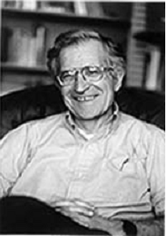
Normal Form
Chomsky normal form
Noam Chomsky
– The Grammar Guy
– 1928 –
– b. Philadelphia, PA
– PhD – UPenn (1955)
• Linguistics
– Prof at MIT (Linguistics)
(1955 - present)

Slide 78
Chomsky normal form
One additional way to simplify a CFG is to simplify each RHS
A CFG is in Chomsky normal form (CNF) iff each production has a RHS that consists of
a single terminal symbol, or
two variable symbols
For any CFG G, with λ not in L(G), there is an equivalent grammar G₁ in CNF.
Must begin the transformation after simplifying the grammar (removing λ, all unit productions, & useless variables)

Slide 79
Converting to Chomsky normal form
A CFG that doesn't generate λ may be converted to CNF by first eliminating all λ-moves and unit productions.
This will give a grammar where each RHS of length less than 2 consists of a lone terminal.
Any RHS of length k > 2 may be broken up by introducing k-2 new variables.
For any terminal a that remains on a RHS, we add a new variable and new rule C_{a} → a.

Slide 80
Converting to CNF: an example
For example, the rule S → AbCD in a CFG G can be replaced by
S → AX, X → bY, Y → CD
Here we don’t change L(G)
After the remaining steps, the new rules would be
S → AX, X → C_{b}Y, Y → CD, C_{b} → b
Again we don’t change L(G)

Slide 81
A more complete example
Consider the grammar with rules
E → E + T | T * F | x, T → T * F | x, F → x
The last rule for each symbol is legal in CNF.
We may replace
E → E + T by E → EX, X → C₊T, C₊ → +
E → T * F by E → TY, Y → C*F, C* → *
T → T * F by T → TZ, Z → C*F, C*→ *

Slide 82
The resulting grammar
The resulting CFG is in CNF, with rules
E → EX | TY | x
T → TZ | x
F → x
X → C₊T
Y → C*F
Z → C*F (or Z could be replaced by Y)
C₊ → +
C* → *

Slide 83
Exercise
Convert the CFGs into Chomsky Normal Forms:
1)
S → ε |ADDA
A → a
C → c
D → bCb
2)
S ➞ bA | aB
A ➞ bAA | aS | a
B ➞ aBB | bS | b
3)
S ➞ abAB
A ➞ bAB | λ
B ➞ BAa | A | λ
4)
S ➞ aS | bS | B
B ➞ bb | C | λ
C ➞ cC | λ

Slide 84
Greibach Normal Form
A CFG G is in Greibach Normal Form if
every production is of the form A → aα , where α∈V* and a ∈Σ (α may be λ) and
S → λ is in G if λ ∈ L(G).
When λ ∈ L(G), we assume that S does not appear on the R.H.S. of any production.
For example, G given by
S → aAB | A, A → bC, B → b, C → c
is in GNF.

Slide 85
Greibach Normal Form
For converting any CFG G into GNF, we use this two technical lemmas:
Lemma 1:
Let G = (V, T, P, S) be a CFG, and A → Bγ be an A-production in P. Let the B-productions be B → β1 | β2 | . . . | βs . Define P1 = (P – {A → Bγ }) ∪ {A→β_{i}γ | 1 ≤ I ≤ s }. Then, G1 = (V, T, P1, S) is a CFG equivalent to G.
Lemma 2:
Let G = (V, T, P, S) be a CFG, and let the set of A-productions be
A→ Aα₁ | . . . |Aα_{r} | β1 | . . . | βs (β_{i}'s do not start with A).
Let Z be a new variable and G1 = (V∪{Z}, T, P1, S), where P1 is defined as follows:
The set of A-productions in P1 are A → β1 | . . . | βs | β1Z | . . . | βsZ
The set of Z-productions in P1 are Z→ α₁ | . . . |α_{r} | α₁Z | . . . | α_{r}Z
The productions for the other variables are as in P. Then G1 is a CFG and equivalent to G.

Slide 86
Conversion to GNF
Step 1:
Eliminate null productions and then construct a grammar G in Chomsky normal form generating L.
Rename the variables as A1, A2, . . . , An with S = A1.
We write G as ({A1, A2, . . . , An}, Σ, P, A1).
Step 2:
To get the productions in the form A_{i} →aγ or A_{i} →A_{j}γ , where j > i, convert the A_{i}-productions (i = 1, 2, . . . , n - 1) to the form A_{i} →A_{i}γ such that j > I, using lemma 2.
Step 3:
Convert A_{n}-productions to the form A_{n} →aγ. Here, the productions of the form A_{n} → A_{n}γ are eliminated using Lemma 2.
The resulting A_{n}-productions are of the form A_{n} →aγ.

Slide 87
Conversion to GNF
Step 4:
Modify the A_{i}-productions to the form A_{i} → aγ for i = 1, 2, . . . , n – 1.
At the end of step 3, the A_{n}-productions are of the form A_{n} →aγ.
The A_{n-1}-productions are of the form A_{n} → aγ ' or A_{n-1} → A_{n}γ .
By applying Lemma 1, we eliminate productions of the form A_{n-1} → A_{n}γ .
The resulting A_{n-1}-productions are in the required form. We repeat the construction by considering A_{n-2}, A_{n-3}, . . . , A¹.

Slide 88
Conversion to GNF
Step 5:
Modify Z_{i}-productions. Every time we apply Lemma 2, we get a new variable. (We take it as Z_{i} when we apply the Lemma 2 for A_{i}-Productions.)
The Z_{i}-productlons are of the form Z_{i} →αZ_{i} or Z_{i} →α (where α is obtained from A_{i} → A_{i}α), and hence of the form Z_{i} → aγ or Z_{i} → A_{k}γ for some k.
At the end of step 4, the R.H.S. of any A_{k}-production starts with a terminal.
So we can apply Lemma 1 to eliminate Z_{i} → A_{k}γ .
Thus at the end of step 5, we get an equivalent grammar G1 in GNF.

Slide 89
Conversion to GNF
Example: Construct a grammar in Greibach normal form equivalent to the grammar
S → AA | a, A → SS | b
Solution:
Step1:
Eliminate null productions and convert G to CNF.
The given grammar is in CNF.
S and A are renamed as A1 and A2, respectively.
So the productions are A1 → A2A2 | a, and A2 → A1A1 | b.
As the given grammar has no null productions and is in CNF we need not carry out step 1.
So we proceed to step 2.

Slide 90
Conversion to GNF
Example: Cont.…
Step2:
Convert the A_{i}-productions (i = 1, 2, . . . , n - 1)
A_{i} → aγ or A_{i} → A_{j}γ such that j > i.
A1-productions are in the required form.
They are A1 → A2A2 | a.
A2 → b is in the required form.
We apply Lemma 1 to A2 → A1A1.
The resulting productions are A2 → A2A2A1, A2 → aA1.
Thus the A2-productions are A2 → A2A2A1, A2 → aA1, A2 → b

Slide 91
Conversion to GNF
Example: Cont.…
Step3:
Convert A_{n}-productions of form A_{n} → A_{n}γ to the form A_{n} → aγ , by applying lemma 2.
We have to apply Lemma 2 to A2-productions as we have A2 → A2A2A1, and let Z2 to be the new variable.
The resulting productions are:
A2 → aA1 A2 → b
A2 → aA1Z2 A2 → bZ2
Z2 → A2A1 Z2 → A2A1Z2

Slide 92
Conversion to GNF
Example: Cont.…
Step4:
Modify the A_{i}-productions to the form A_{i} → aγ for i = 1,2, . . . , n–1 by applying lemma 1.
The A2-productions are A2 → aA1 | b | aA1Z2 | bZ2.
Among the A1-productions we retain A1 → a and eliminate A1 → A2A2 using Lemma 1.
The resulting productions are A1 → aA1A2 | bA2, A1 → aA1Z2A2 | bZ2A2
The set of all (modified) A1-productions is
A1 → a | aA1A2 | bA2 | aA1Z2A2 | bZ2A2

Slide 93
Conversion to GNF
Example: Cont.…
Step5:
Modify Z_{i}-productions, which are of the form Z_{i} → aγ or Z_{i} → A_{k}γ for some k.
The Z2-productions to be modified are:
Z2 → A2A1, Z2 → A2A1Z2
We apply Lemma 1 and get
Z2 → aA1A1 | bA1 | aA1Z2A1 | bZ2A1
Z2 → aA1A1Z2 | bA1Z2 | aA1Z2A1Z2| bZ2A1Z2

Slide 94
Conversion to GNF
Example: Cont.…
Hence the equivalent grammar is
G' = ({A1, A2, Z2}, {a, b}, P1, A1)
where P1 consists of
A1 → a | aA1A2 | bA2 | aA1Z2A2 | bZ2A2
A2 → aA1 | b | aA1Z2 | bZ2
Z2 → aA1A1 | bA1 | aA1Z2A1 | bZ2A1
Z2 → aA1A1Z2 | bA1Z2 | aA1Z2A1Z2| bZ2A1Z2
G' is the required equivalent grammar in GNF.

Slide 95
Pumping Lemma for Context Free Languages
Recall the pumping lemma for regular languages.
It told us that if there was a string long enough to cause a cycle in the DFA for the language, then we could “pump” the cycle and discover an infinite sequence of strings that had to be in the language.
For CFL’s the situation is a little more complicated.
We can always find two pieces of any sufficiently long string to “pump” in tandem.
That is: if we repeat each of the two pieces the same number of times, we get another string in the language.

Slide 96
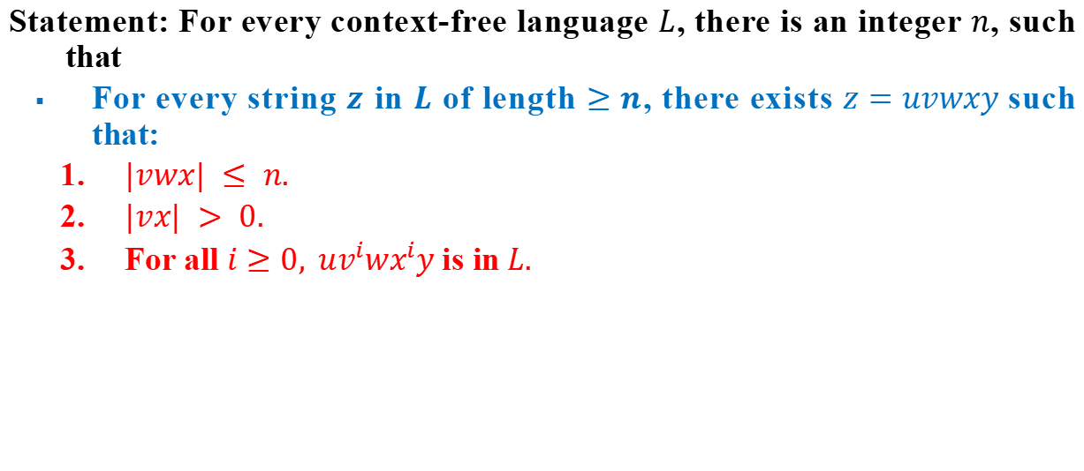
Statement of the CFL Pumping Lemma
Statement: For every context-free language $L$, there is an integer $n$, such that
For every string $z$ in $L$ of length $≥n$, there exists $z=uvwxy$such that:
$|vwx| ≤ n.$
$|vx| > 0.$
For all $i≥0, uv^{i}wx^{i}y$is in$L.$

Slide 97
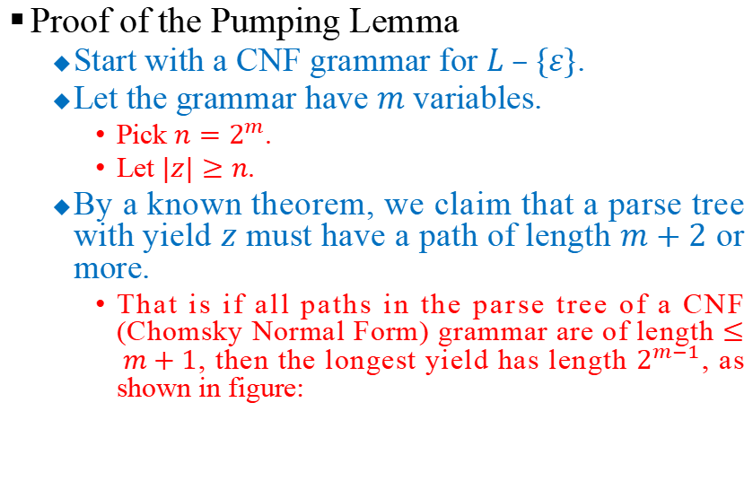
Statement of the CFL Pumping Lemma
Proof of the Pumping Lemma
Start with a CNF grammar for $L – \{ε\}$.
Let the grammar have $m$ variables.
Pick $n=2^{m}$.
Let $|z|≥n$.
By a known theorem, we claim that a parse tree with yield $z$ must have a path of length $m+2$ or more.
That is if all paths in the parse tree of a CNF (Chomsky Normal Form) grammar are of length $≤ m+1$, then the longest yield has length $2^{m−1}$, as shown in figure:
m variables
one terminal
2^{m-1} terminals

Slide 98
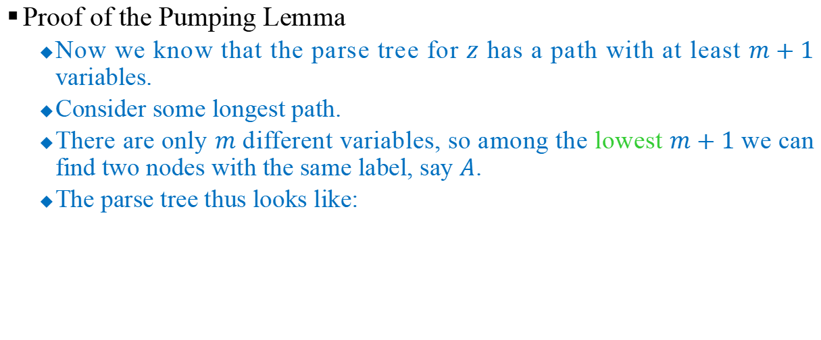
Statement of the CFL Pumping Lemma
Proof of the Pumping Lemma
Now we know that the parse tree for $z$ has a path with at least $m+1$ variables.
Consider some longest path.
There are only $m$ different variables, so among the lowest $m+1$we can find two nodes with the same label, say $A$.
The parse tree thus looks like:

Slide 99
Statement of the CFL Pumping Lemma
Proof of the Pumping Lemma
Can’t both
be ε.
A
A
A
A
u
v
x
y
A
A
v
x
v
w
x
u
v
w
x
y
Pump zero, one, two, etc.

Slide 100
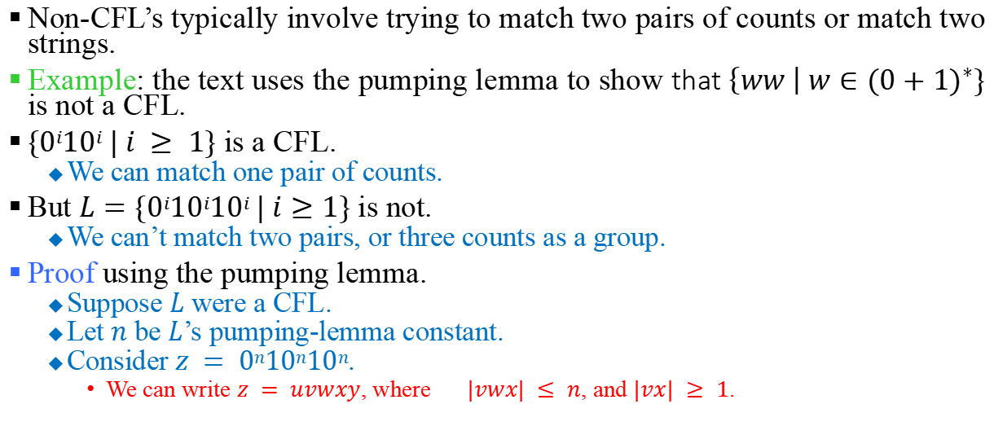
Using the Pumping Lemma
Non-CFL’s typically involve trying to match two pairs of counts or match two strings.
Example: the text uses the pumping lemma to show that $\left\{ww \right| w∈{(0+1)}^{∗}\}$ is not a CFL.
$\{0i10i | i ≥ 1\}$ is a CFL.
We can match one pair of counts.
But $L=\{0i10i10i | i≥1\}$ is not.
We can’t match two pairs, or three counts as a group.
Proof using the pumping lemma.
Suppose $L$ were a CFL.
Let $n$ be $L$’s pumping-lemma constant.
Consider $z = 0n10n10n$.
We can write $z = uvwxy$, where $|vwx| ≤ n$, and $|vx| ≥ 1$.

Slide 101
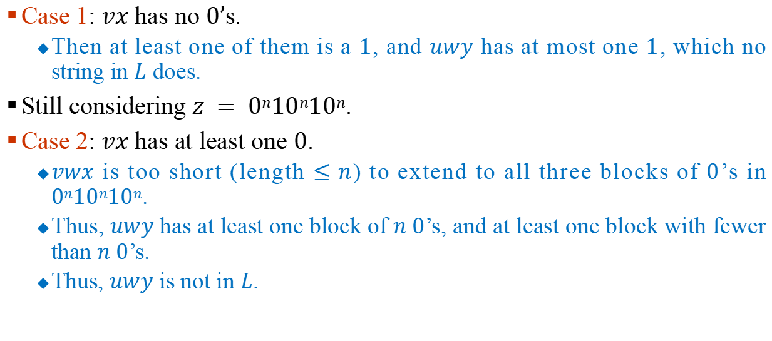
Using the Pumping Lemma
Case 1: $vx$ has no $0’$s.
Then at least one of them is a $1$, and $uwy$ has at most one $1$, which no string in $L$ does.
Still considering $z = 0n10n10n$.
Case 2: $vx$ has at least one $0$.
$vwx$ is too short (length ≤ $n$) to extend to all three blocks of $0$’s in $0n10n10n$.
Thus, $uwy$ has at least one block of $n 0$’s, and at least one block with fewer than $n 0$’s.
Thus, $uwy$ is not in $L$.

Slide 102
Thanks!!!

